Slide 1



PIZZA SALES SQL QUERIES
A. KPI’s
Q 1: What is the Total Revenue of Pizza sales?
Q 2: What is the Average price per order of Pizza sales?
Q 3: What is the Total Pizza’s sold?

Slide 2


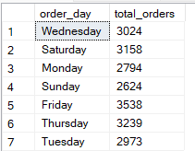
Q 4: What is the Total number of orders placed ?
Q 5: What is the average pizza’s per order placed ?
Q 6: Daily order trend?

Slide 3
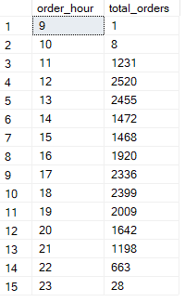
Q 7: Hourly order trend?
Q 8: Percentage of sales by pizza category?

Slide 4
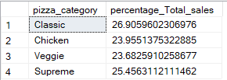
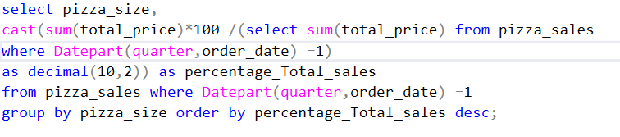
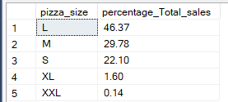
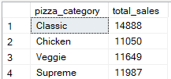
Q 9: Percentage of sales by pizza size by quarter?
Q 10: Total sales by Pizza Category?

Slide 5
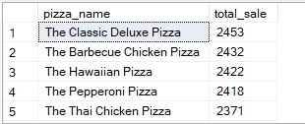
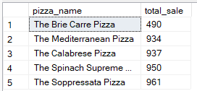
Q 11: Total 5 best seller pizza?
Q 12: Total 5 least selling pizza?

